Slide 1
Module: 3
CST 202
Computer Organization and Architecture
PART1
Arithmetic algorithms: Algorithms for multiplication and division

Slide 2
ARITHMETIC ALGORITHMS –
Algorithms for multiplication and division
(restoring method) of binary numbers — Array multiplier —Booth’s multiplication algorithm
Pipelining – Basic Principles, classification of pipeline processors. instruction and arithmetic pipelines (Design examples not required), hazard detection and resolution.

Slide 3
Multiplication of positive numbers
The product of two n-digit numbers can be accommodated in 2n digits, so the product of the two 4-bit numbers fits into 8 bits.
In the binary system,
  If the multiplier bit is 1, the multiplicand is entered in the appropriate position to be added to the partial product.
  If the multiplier bit is 0, then 0’s are entered

Slide 4
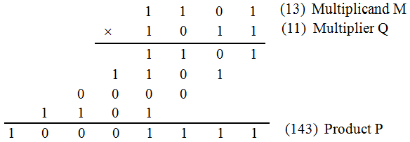
Manual Multiplication Algorithm

Slide 5
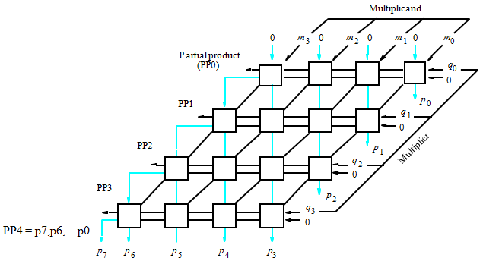
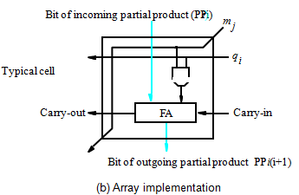
Array Multiplication
Binary multiplication of positive operands can be implemented in a combinational 2D logic array.
The main component in each cell is a full adder FA.
The AND gate in each cell determines whether a multiplicand bit, mj, is added to the incoming partial product bit, based on the value of the multiplier bit, qi.
Each row i adds the multiplicand to the incoming partial product, PPi, to generate the outgoing partial product, PP(i+1), if qi=1.
If qi=0, PPi is passed vertically downward unchanged.
PP0 is all 0s, and PP4 is the desired product.
The multiplicand is shifted left one position per row by the diagonal signal path.

Slide 6
Array Multiplier

Slide 7
Array Multiplication
Disadvantages:
An n bit by n bit array multiplier requires n2 AND gates and n(n-2) full adders and n half adders.(Half adders are used if there are 2 inputs and full adder used if there are 3 inputs).

Slide 8
Sequential Circuit Binary Multiplier
To perform multiplication using the adder circuitry in the ALU for a number of sequential steps.
The circuit performs multiplication by using a single n-bit adder n times to implement the spatial addition performed by the n rows of ripple carry adders.
Register A & Q combined hold PPi while multiplier bit qi generates the signal Add/Noadd.
This signal controls the addition of the multiplicand, M to PPi to generate PP(i+1). The product is computed in n cycles.
The partial product grows in length by one bit per cycle from the initial vector PP0, of n 0s in A.
The carry out from the adders is stored in flip flop C.

Slide 9
Sequential Circuit Binary Multiplier…
At the start, the multiplier is loaded into Q, multiplicand into M and C & A are cleared to 0.
At the end of each cycle, C, A & Q are shifted right one bit position to allow for growth of the partial product as multiplier is shifted out of Q.
Because of this shifting, multiplier bit qi appears at the LSB of Q to generate Add/Noadd signal at the correct time, starting with q0 during first cycle, q1 during the second cycle, and so on.
After they are used, the multiplier bits are discarded by the right shift operation.
The carry-out from the adder is the leftmost bit of PP(i+1), and it must be held in the C to be shifted right with the contents of A & Q.
After n cycles, the high order half of the product is in A and the low order half is in Q

Slide 10
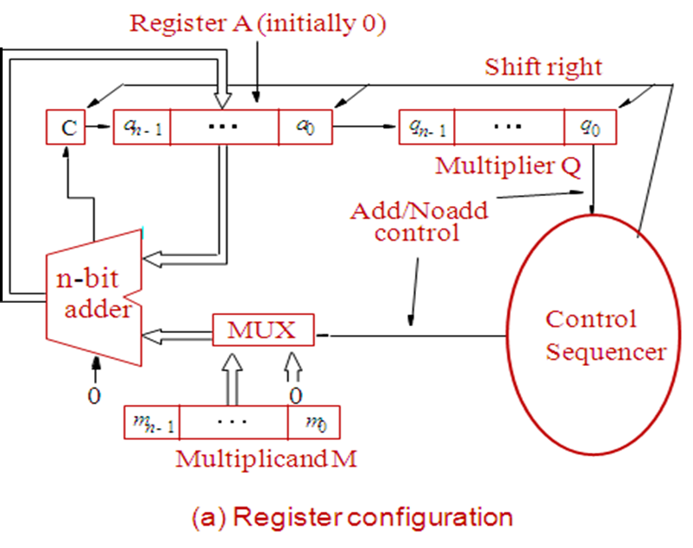
Figure - Sequential Circuit Binary Multiplier

Slide 11
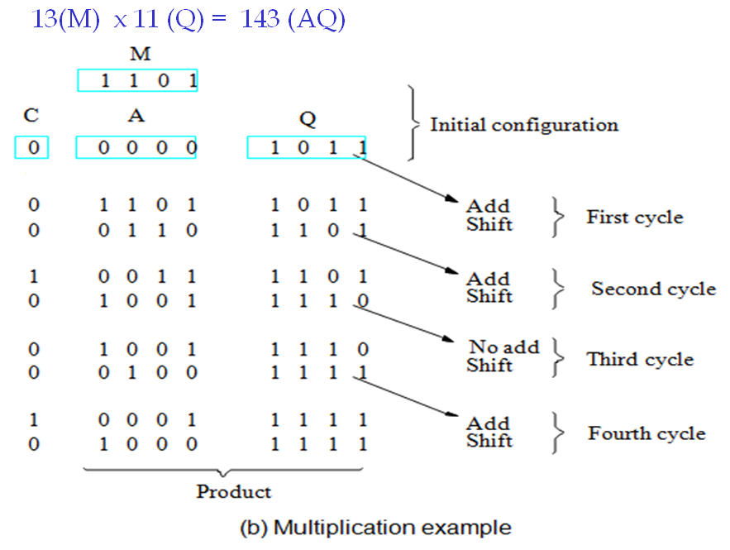
Example - Sequential Circuit Binary Multiplier

Slide 12
Signed Operand Multiplication
Consider the case of a positive multiplier and a negative multiplicand.
When we add a negative multiplicand to a partial product, we must extend the sign bit value of the multiplicand to the left as far as the product will extend.
The hardware used for the multiplication of positive numbers can be used for negative multiplication if it provides for sign extension of the partial products.
For eg:, -13 (5 bit signed operand) x +11 to get the 10 bit product, -143.
13 –> 1101
+13 -> 01101
-13 -> 10010 +1
10011 -> -13

Slide 13
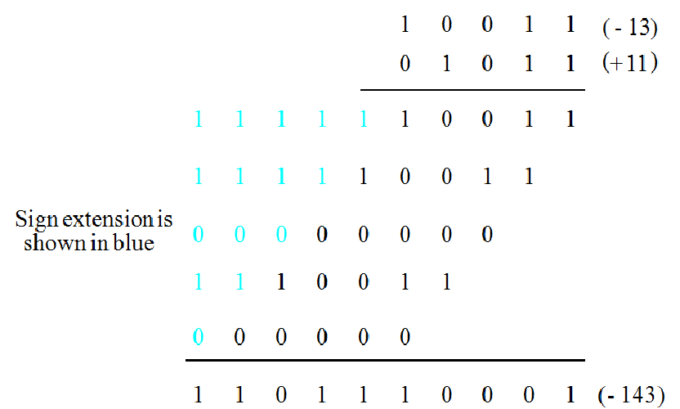
Example - Signed Operand Multiplication
Sign extension of negative multiplicand.

Slide 14
Signed Operand Multiplication…
For a negative multiplier, form the 2’s-complement of both the multiplier and the multiplicand and proceed as in the case of a positive multiplier.
This is possible because complementation of both operands does not change the value or the sign of the product.
A technique that works equally well for both negative and positive multipliers – Booth algorithm.

Slide 15
Booth’s Algorithm
Booth’s algorithm is a powerful direct algorithm to perform signed number multiplication.
The algorithm is based on the fact that any binary number can be represented by the sum and difference of other binary numbers.
Features
  It handles both + ve & - ve numbers uniformly.
  It achieves some efficiency in the number of additions required, when the multiplier has a few large blocks of 1’s.

Slide 16
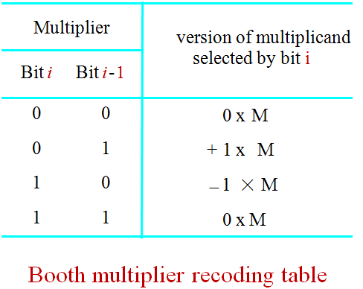
Booth Algorithm

Slide 17
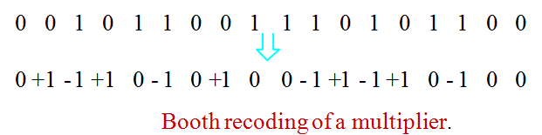
Booth Algorithm
In general, in the Booth scheme, -1 times the shifted multiplicand is selected when moving from 0 to 1, and +1 times the shifted multiplicand is selected when moving from 1 to 0, as the multiplier is scanned from right to left.
Booth algorithm can be extended to any number of blocks of 1s in a multiplier, including the situation in which a single 1 is considered a block.
The case when the LSB of the multiplier is 1 is handled by assuming that an implied 0 lies to its right.

Slide 18
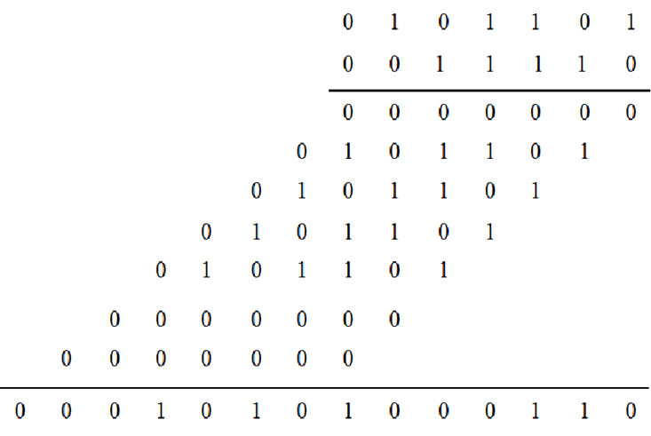
Booth’s Algorithm
Consider in a multiplication, the multiplier is positive 0011110, how many appropriately shifted versions of the multiplicand are added in a standard procedure?

Slide 19
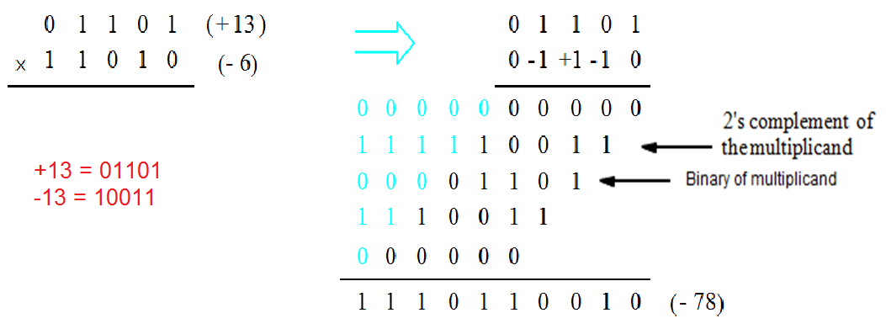
Booth’s Algorithm
Booth multiplication with a negative multiplier

Slide 20
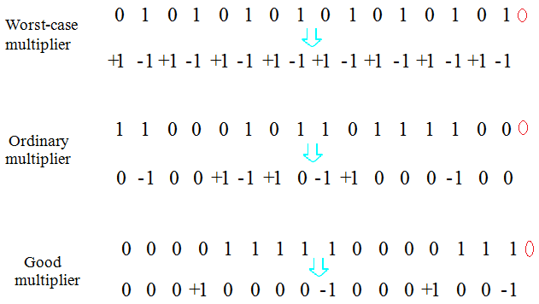
Booth’s Algorithm
Best case – a long string of 1’s (skipping over 1s)
Worst case – 0’s and 1’s are alternating

Slide 21
The transformation 011….110 to 100….0-10 is called skipping over 1s.
Only a few versions of the shifted multiplicand must be added to generate the product, thus speeding up the multiplication operation.
However in worst case, that is of alternate 1s and 0s in the multiplier, each bit of the multiplier selects a summand.

Slide 22
Algorithm & Flowchart for Booth Multiplication
Multiplicand is placed in BR and Multiplier in QR
Accumulator register AC, Qn+1 and Sequence counter SC are initialized to 0.
Compare Qn and Qn+1 and perform the following
01 –> AC=AC+BR
10 –> AC=AC+BR’+1
00 –> No arithmetic operation 11-> No arithmetic operation
ASHR- Arithmetic Shift right AC,QR
Decrement SC by 1
The final product will be store in AC, QR

Slide 23
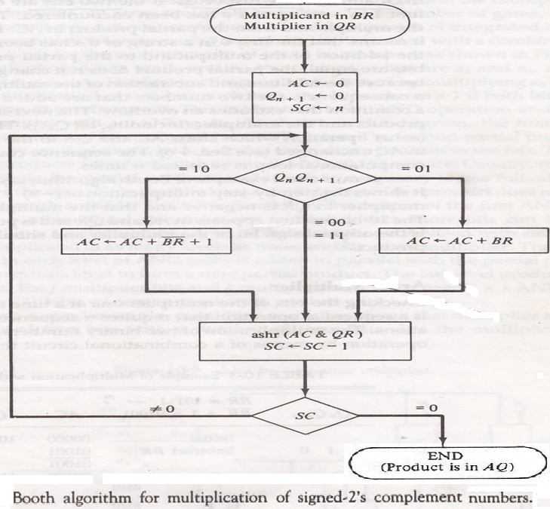
Booth’s Algorithm - Flowchart

Slide 24
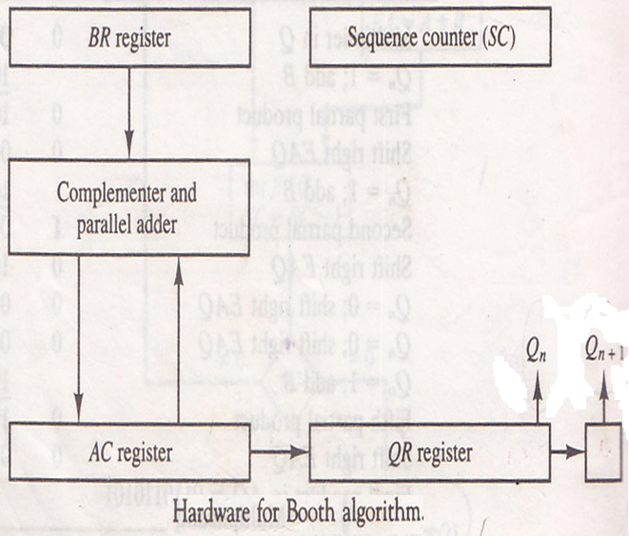
Booth’s Algorithm - Hardware

Slide 25
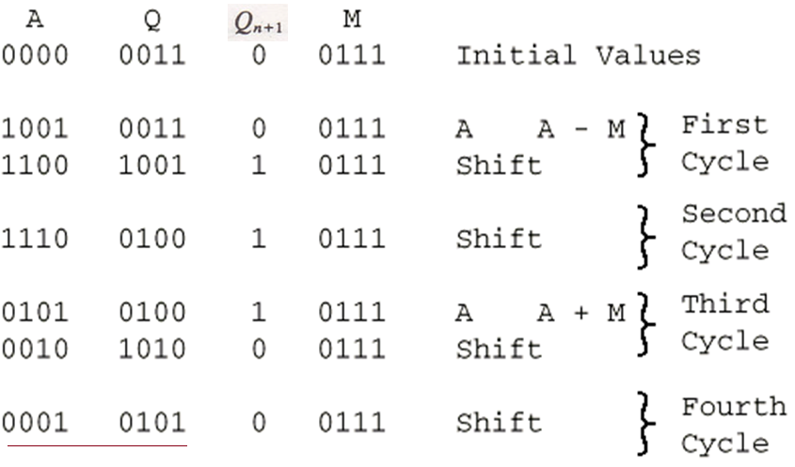
Example of Booth’s Algorithm ( 7 * 3 = 21)

Slide 26
Example: 6 x -1 = -6 (-1 = 1111)
A Q Q_{n+1} M C/P Comment
0000 1111 0 0110 Initial Values
1010 1111 1 0110 10 A <- A - 6 = -6
1101 0111 1 0110 >>1
1110 1011 1 0110 11 >>1
1111 0101 1 0110 11 >>1
1111 1010 1 0110 11 >>1 A:Q = -6

Slide 27
Example: -3 * 2 = -6 (-3 = 1101)
A Q Q_{n+1} M C/P Comment
0000 1101 0 0010 Initial Values
1110 1101 0 0010 10 A <- A - 2 = -2
1111 0110 1 0010 >>1
0001 0110 1 0010 01 A <- A + 2
0000 1011 0 0010 >>1
1110 1011 0 0010 01 A <- A - 2 = -2
1111 0101 1 0010 >>1
1111 1010 1 0010 11 >>1 A:Q = -6

Slide 28
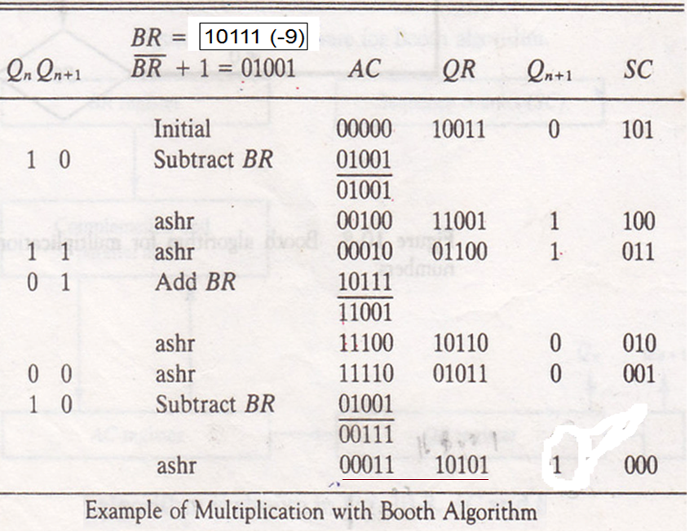
Example: -9 x -13 = 117 (-13 = 10011)

Slide 29
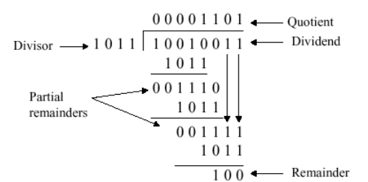
Manual Division
10010011 by 1011

Slide 30
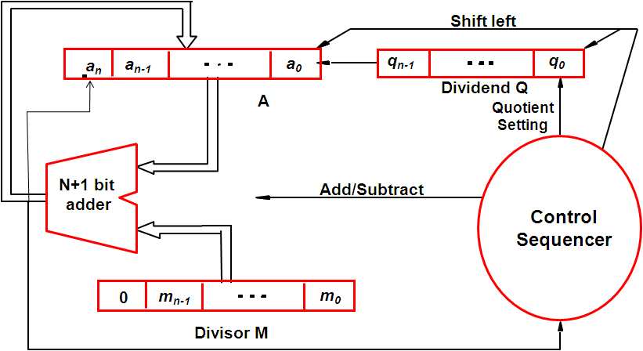
Circuit arrangement for Restoring division

Slide 31
Status of the registers
At the begining of the operarion.
n bit positive devisor is loaded into register M
n bit positive dividend is loaded into register Q
After the division is complete:
N bit quotient is in register Q
Remainder is in Register A

Slide 32
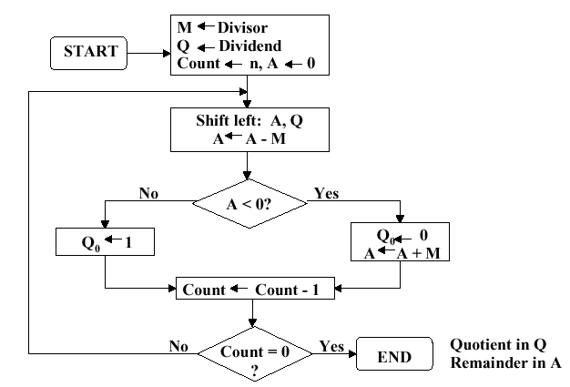
The unsigned numbers division algorithm with restoring method

Slide 33
Algorithm for Restoring Division
Do the following n times:
1. Shift A and Q left one binary position.
2. Subtract M from A and place the answer back in A
3. If the sign of A is 1, set q₀ to 0 and add M back to A
(ie. restore A); otherwise if sign of A is 0, set q₀ to 1.

Slide 34
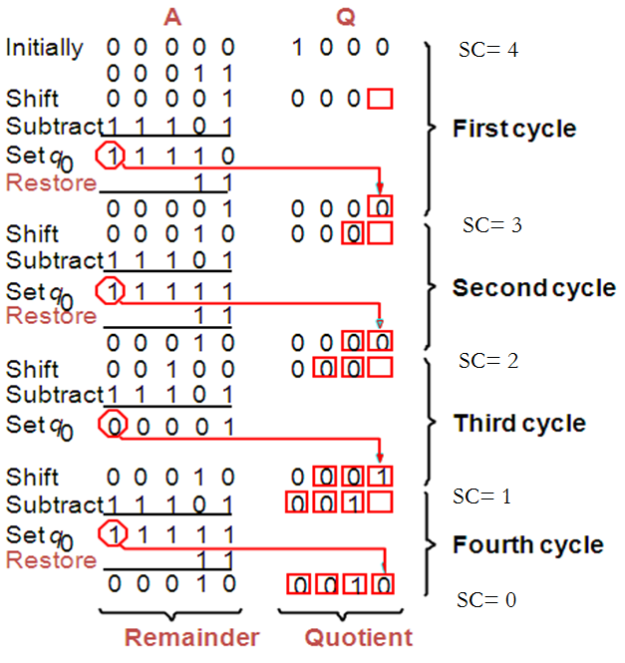
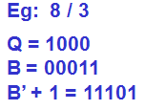
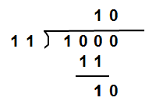
Restoring division Example

Slide 35
Non-restoring Division
The restoring algorithm can be improved by avoiding the need for restoring A after an unsuccessful subtraction.
In restoring method,
If A is positive, we shift left and subtract M. i.e. we perform 2A-M.
If A is negative, we restore it by performing A + M,
then we shift it left and Subtract M.
This is equivalent to performing 2A+M
Note: Logic circuit is same as in Restoring division

Slide 36
Non-restoring Division algorithm
Step1: Do the following n times.
If sign of A is 0, shift A & Q left one position and subtract M from A; else if A=1, shift A and Q left and add M to A.
2. Now, if the sign of A is 0, set q0 to 1; else if A=1, set q0 to 0
Step2: If sign of A is 1, add M to A.
Note: Step 2 is needed to leave the proper remainder in A at the end of the n cycles of step1.

Slide 37
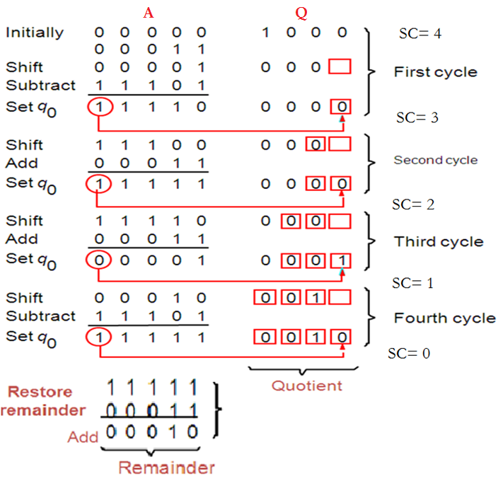
Non-Restoring division Example: 8/3

